Slide 1
Vision Based Wheel Chair Control for Quadriplegics
PROJECT SUPERVISOR
Project members
Ms. Punithavathy Mohan , M.E
S Vidya Chandran 1306046
Subham Prasad 1306073
A Siddhartha Bhaskar 1306078

Slide 2
Contents
Objective of the Project
Abstract
New Advancements over Existing System
Block Diagram
Brief Explanation of the Architecture
Advantages
Details of Hardware and Software Design
References

Slide 3
Objective of the Project
To design a vision based wheel chair control system.
System uses a camera to acquire user images and analyzing user intent using head gestures.
Notes:
The world population is increasing faster and also the people with disabilities(PWD) ratio increasing.
They face barriers at their each turn and they need some helpers in their works.
The assistive device acts as a boon for them.
The most wide spread assistive device is the wheel chair.

Slide 4
Abstract
To make lives of the people suffering from paralysis self-reliant, which will thereby reinstate their confidence and their happiness.
Eye movement controls the motion of the wheel chair.
Partial movement of crippled patients’ eye and tilting of head help detecting these movements.
MATLAB based image processing is carried out on the captured images to guide the motors wired to the Microcontroller to move in the desired direction.

Slide 5
New Advancements over Existing Systems
The existing systems in the market use a facial expression or tongue monitored systems, where some body part of the person is wired to some electrical circuitry. But, it is very annoying for a person to have something wired to his body all the time.
The novelty of our system lies in the fact that no part of the system physically interacts with the user, making him feel comfortable.

Slide 6
Block Diagram-1
Capturing of the images
Image Processing
Interface
Micro-controller
Wheel Chair Assembly

Slide 7
Brief Explanation of the Architecture
Image Capture:
Using a webcam, series of images are captured and are stored when the MATLAB script is executed.
Image Processing and Eye Detection:
The captured snapshots are converted into gray scale images for greater accuracy which enables the detection of the eyes better.
Movement Detection:
The idea is to compare the current position of the eye with the previous position. Thus, the difference in the co-ordinates will help us to predict the motion.
Motor Signals:
By tilting head of the person sitting on the wheel chair, valid right/left decisions are made and sent to the motor via microcontroller.

Slide 8
Hardware Requirements
ATmega 328P microcontroller(Arduino)
Motor and its Circuitry
LCD(16x2)
MAX 232
Prototype of a wheel chair used

Slide 9
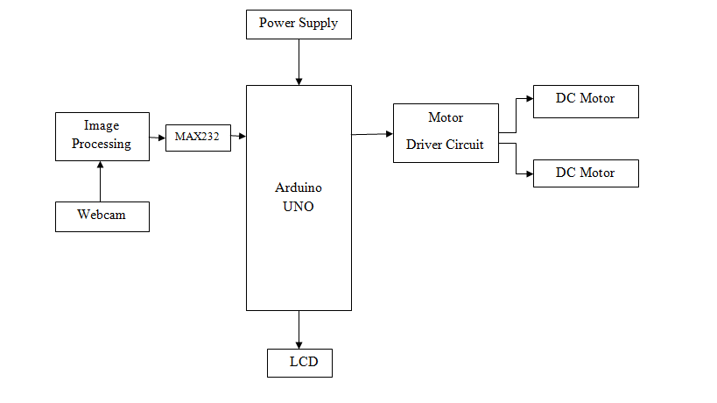
Block Diagram-2

Slide 10
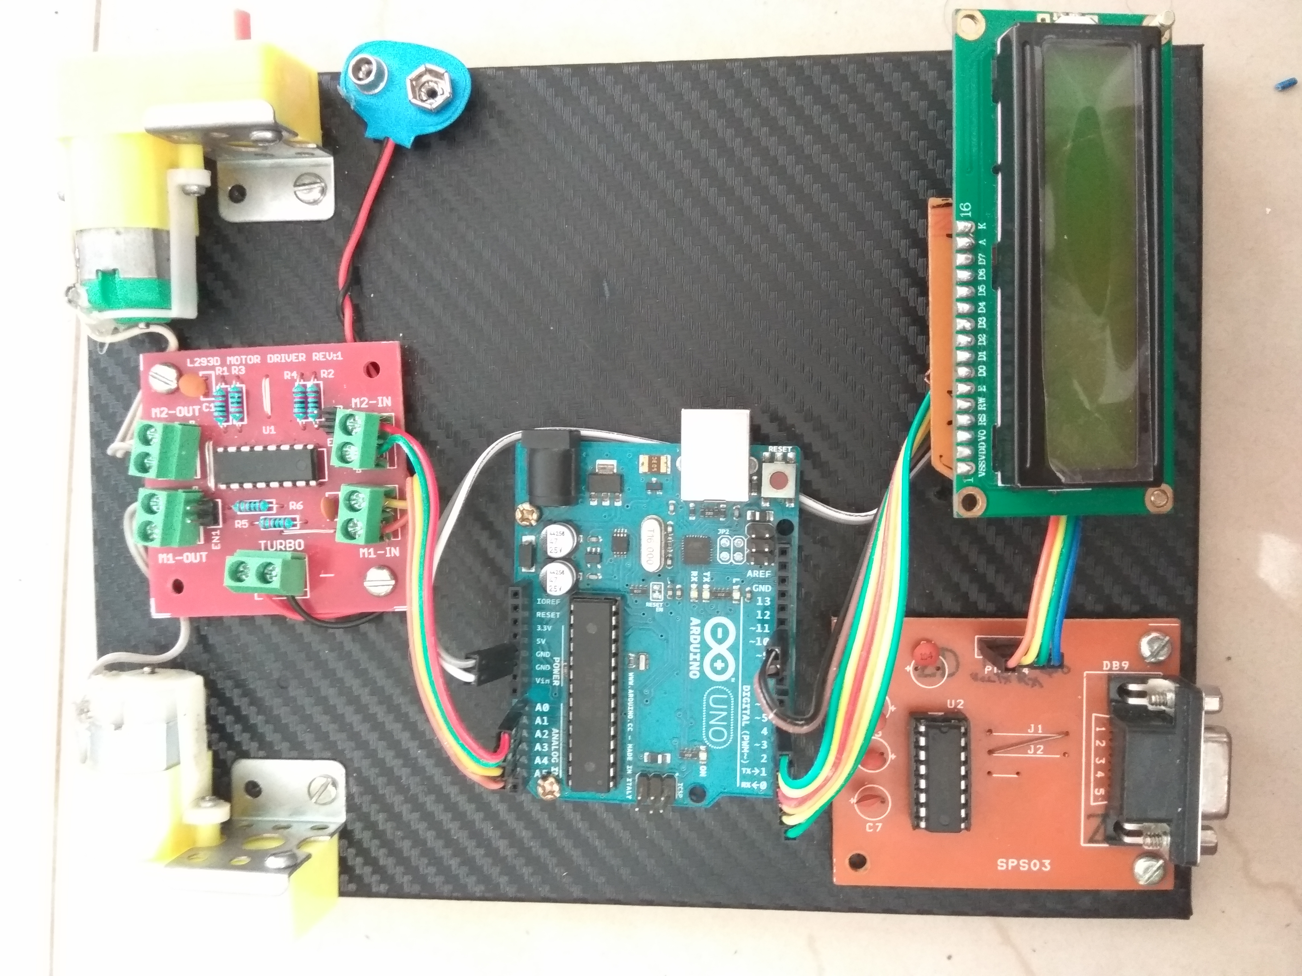
Hardware

Slide 11
Software Requirements
MATLAB R2015b
Plug in:
Computer vision toolbox
Image Acquisition Toolbox
Arduino Package

Slide 12
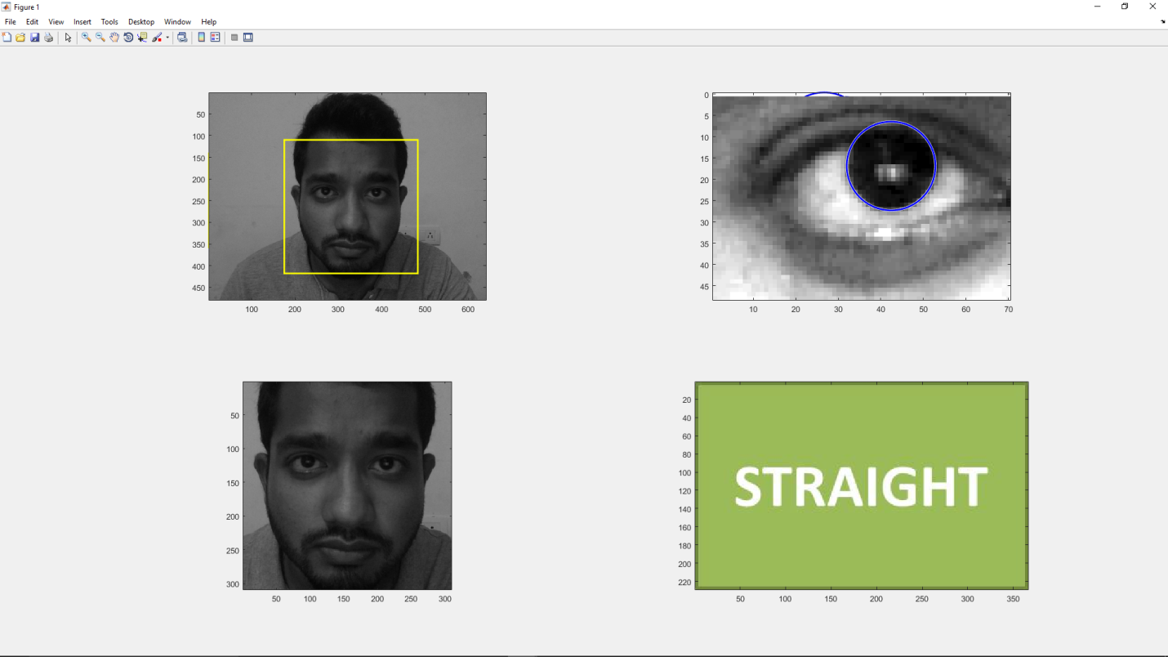
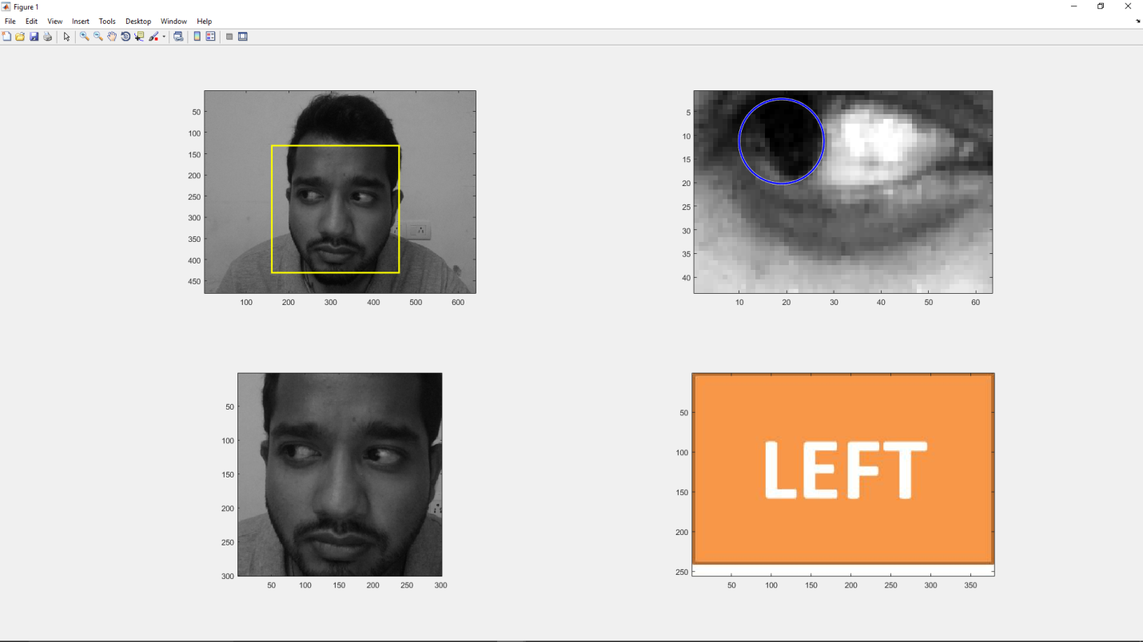
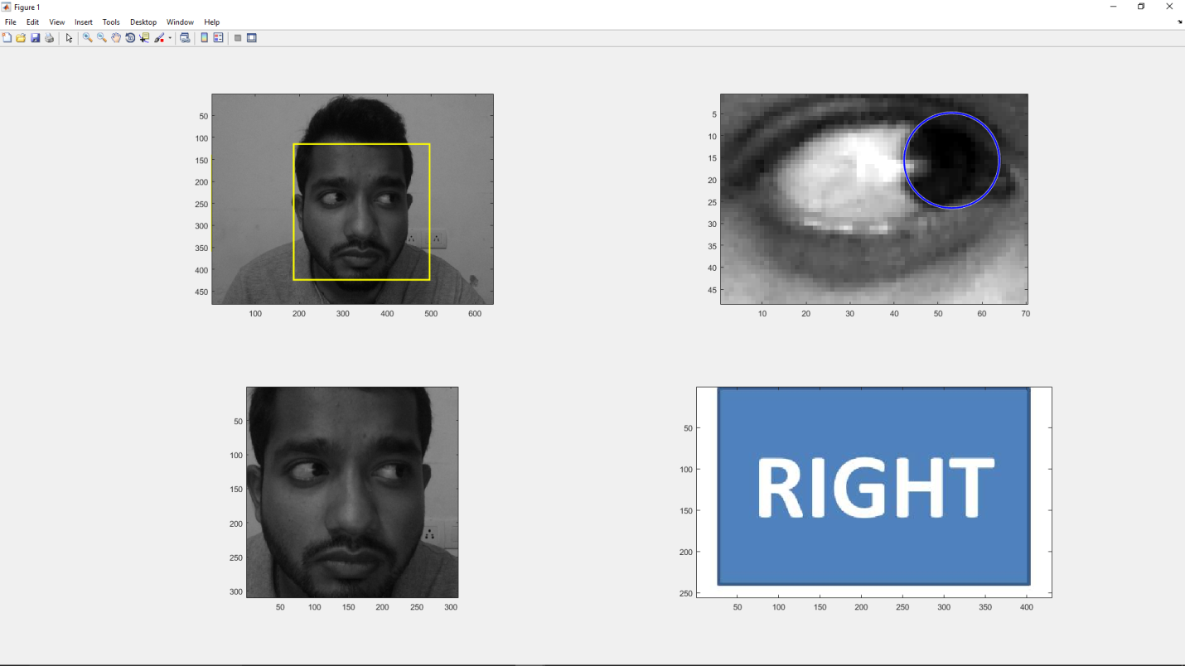

Slide 13
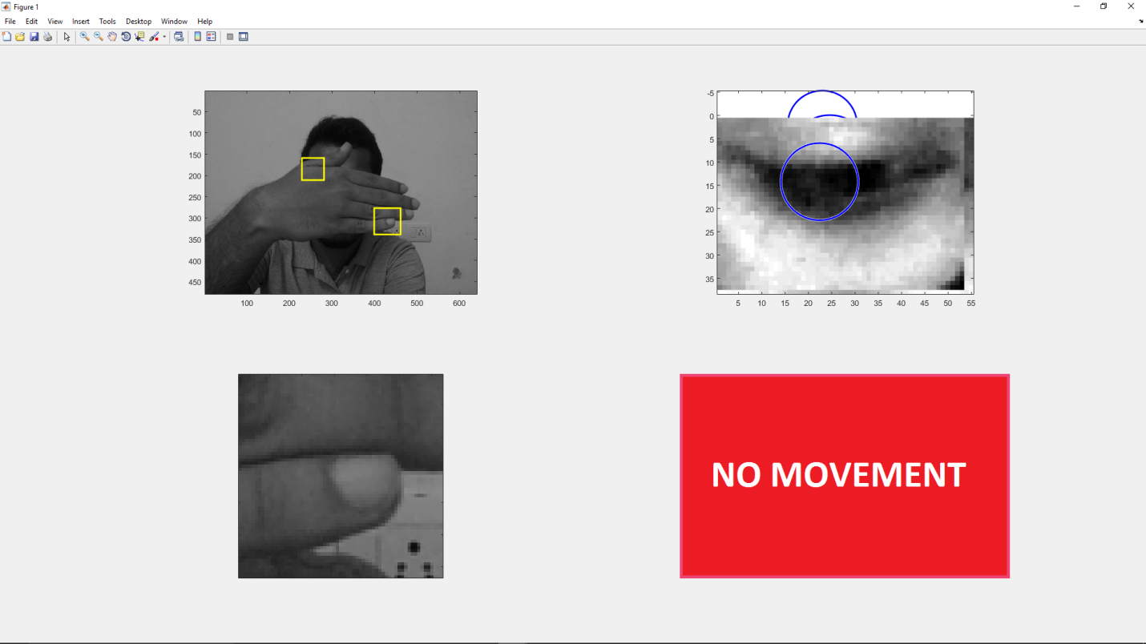

Slide 14
Further Enhancements
To provide remote access to the system using a mobile app
Home Automation can be provided
To incorporate safety features

Slide 15
References
S. Tameemsultana and N. Kali Saranya, “Implementation of Head and Finger Movement Based Automatic Wheel Chair”, Bonfring International Journal of Power Systems and Integrated Circuits, vol. 1, Special Issue, pp 48-51, December 2011.
S. Vijayprasath, DR. Rsukanesh and S. palanival Rajan "Innovative Techniques using wireless sensors in designing smart system for disabled patints" International Journal of power control signals and computation(IJPCSC) VOL. 1 NO. 4
Ankur Thakkar, Darshan Shah, “ Eye monitored Wheel Chair Control”
Viola Johns Algorithm https://en.wikipedia.org/wiki/Viola%E2%80%93Jones_object_detection_framework

Slide 16
Queries
If any

Slide 17


